Slide 1
Infections of the Kidney and Urinary Tract
Presenters: Evalyne Gasper
Victor Njunwa
Facilitator: Prof. E. Maro

Slide 2
OUTLINE
Introduction
Epidemiology
Classification
Risk Factors and Pathogenesis
Clinical presentation
Diagnosis
Treatment
References

Slide 3
URINARY TRACT INFECTION
UTIs is a spectrum of diseases due to invasion of microorganisms at any part of urinary system
It can be from the renal cortex up to the urethral meatus
UTIs are commonly caused by bacteria but also by other pathogens i.e fungal
ESBL-producing E. coli rates >40% in community & hospital strains

Slide 4
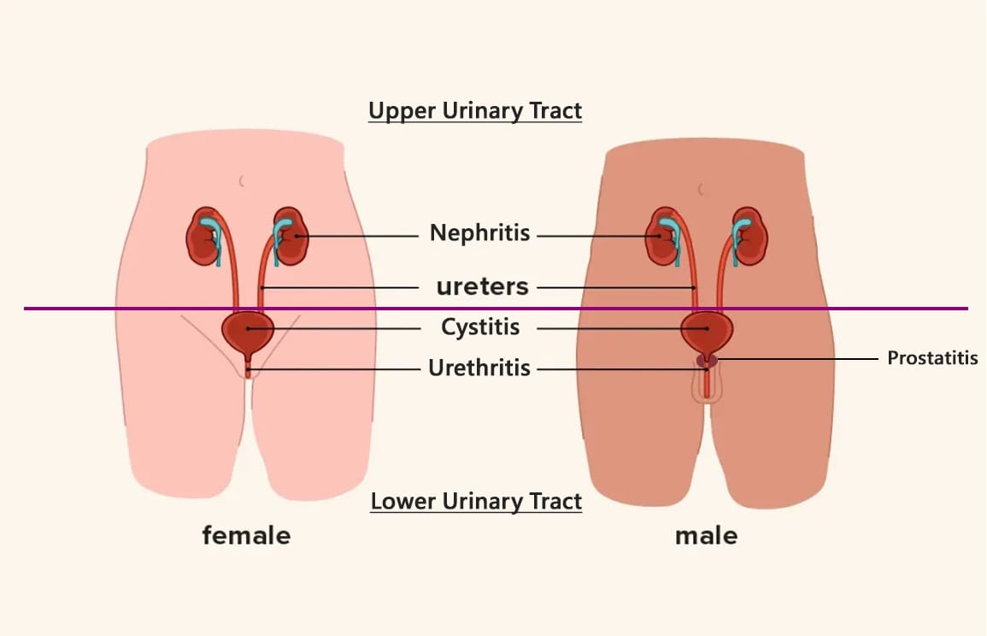
...contd

Slide 5
EPIDEMIOLOGY
UTIs are 2nd most common bacterial infection worldwide (150 million case/year)
SSA has 32.1% prevalence while in Tanzania between 22.8% (Mwanza) to 41 % (Morogoro) prevalence has been reported
Urinary tract is the source in 25% of all sepsis cases (Sepsis‑3 cohorts).
ICU mortality for urosepsis ranges from 10–30%.
Resistance is rising globally, esp. ESBL‑producing Enterobacterales.

Slide 6
RISKS
In adults UTIs are much more common in women than men
Lifetime risk in women 53% vs Men prior age of 50 lifetime risk 14%
  Female urethra: 3–4 cm (vs 20 cm male)
  Periurethral glands and vaginal flora serve as bacterial reservoirs
  Prostate secretions (zinc, spermine): bacteriostatic in men
Catheterization: increases incidence of bacteriuria 3-8% a day
  Tanzanian ICU CAUTI rate: 8.1–12.4/1000 catheter days
Immunosuppression: DM (10.8–16%) and HIV (12.5%)
Pregnancy (8%) and Anatomical Anomalies (33.3%)

Slide 7
CLASSIFICATION FRAMEWORKS
Classification Axis 1 – Anatomical
Classification Axis 2 – Clinical Complexity
Lower UTI
Uncomplicated
Cystitis, Urethritis, Prostatitis
Young, non-pregnant women; no structural/functional abnormality
Upper UTI
Complicated
Pyelonephritis, Renal abscess, Perinephric abscess
Male sex, pregnancy, DM, immunosuppression, obstruction, catheter, structural anomaly
Urosepsis
CAUTI
Sepsis/septic shock originating from urinary tract
organ dysfunction (SOFA ≥2) arising from urinary source
Bacteriuria ≥48h post-catheterisation with symptoms
Asymptomatic Bacteriuria
Recurrent
≥10⁵ CFU/mL ×2 (women) or ×1 (men/catheter)
≥2 episodes/6 months or ≥3/year; relapse vs re-infection
Refs: IDSA UTI Guidelines (Gupta et al., CID 2011); EAU Urological Infections 2024; Hooton TM, NEJM 2012

Slide 8
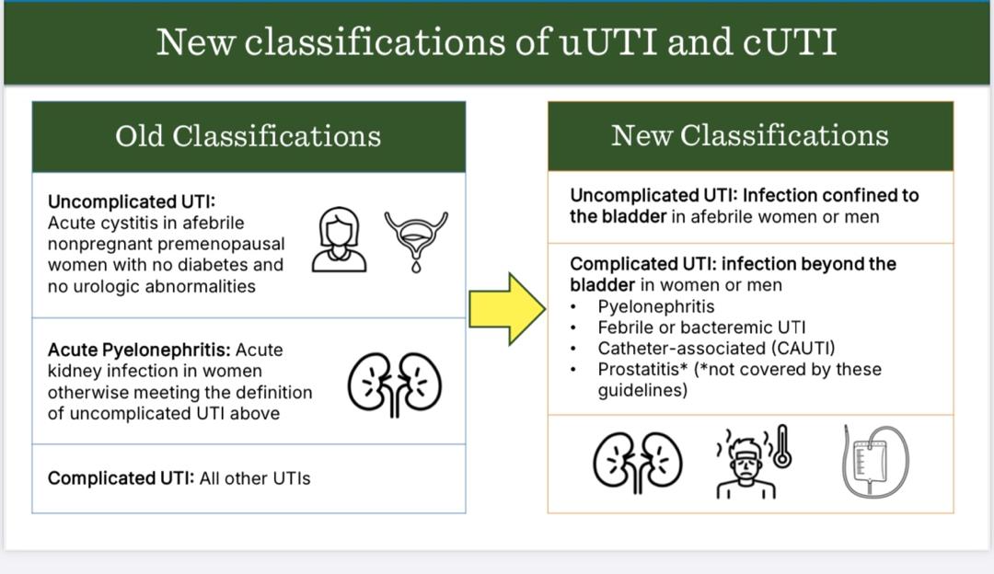

Slide 9
PATHOGENESIS OF UTIs
Ascending (>95%): periurethral flora → urethra → bladder → upper tract
Hematogenous: S. aureus, Candida, Salmonella, M. tuberculosis
Lymphatic: direct spread from bowel (rare; controversial)
Direct extension: fistula, pelvic surgery, trauma
Biofilm-mediated: catheters, stents, calculi – creates protected niche

Slide 10
PATHOGENESIS OF UTIs
Most occur via ascending route
Colonization: periurethral mucosa by enteric uropathogens
Adhesion: Type 1 fimbriae (FimH) attach to bladder epithelium
Invasion : Actin-dependent endocytosis intracellular bacterial communities (IBC)
Host innate immune activation: cytokine release and neutrophil recruitment - Pyuria
Filamentation: bacteria elongate to resist neutrophil phagocytosis
Ascension to kidney: P fimbriae bind globosides on upper tract urothelium → pyelonephritis

Slide 11
Host Defence Mechanisms
HOST DEFENCE MECHANISM
Physical / Mechanical
Innate Immunity
Urinary flow – washout effect (critical threshold: <0.5 mL/min)
Tight junction proteins (uroplakin, claudin)
Tamm-Horsfall protein (uromodulin): mannose-rich decoy – traps type-1 fimbriated UPEC
Vesico-ureteric junction competence; ureteral peristalsis
Toll-like receptors (TLR4, TLR5, TLR11) on urothelium → NF-κB → IL-6, IL-8, CXCL1
Defensins (hBD-1,2,3): constitutive & inducible antimicrobial peptides in urothelium
Complement cascade: bactericidal + opsonisation
Neutrophil recruitment within 2h of UPEC adherence (mast cell–dependent, TLR4-mediated)
Adaptive Immunity
Chemical Barriers
Secretory IgA in urinary tract: blocks adhesion
Local Th1 > Th2 response in pyelonephritis
Memory T cells; risk of immunodeficiency (HIV, DM, immunosuppression)
Urinary pH <5.5 and >7.5 bacteriostatic
High osmolality (>800 mOsm) inhibits bacterial growth
Lactoferrin: iron sequestration – limits bacterial proliferation
Organic acids (hippuric, benzoic)
Refs: Schilling et al., JCI 2012; Hannan et al., Nat Rev Urol 2018; Thumbikat P, Mucosal Immunol 2010; Anderson et al., Science 2003

Slide 12
MAJOR UROPATHOGENS – COMMUNITY & HOSPITAL-ACQUIRED
Organism
% Community
% Hospital/ICU
Key Virulence
E. coli (UPEC)
~80%
~50%
Fimbriae, siderophores, hlyA, CNF1
Klebsiella pneumoniae
5–10%
15–20%
Capsule (K1/K2), siderophores, hypervirulent hvKP
Staphylococcus saprophyticus
5–15%*
<2%
Novobiocin resistance, surface adhesins
Enterococcus faecalis/faecium
2–5%
10–15%
Cytolysin, aggregation substance, VRE (faecium)
Pseudomonas aeruginosa
<1%
10–15%
Biofilm, T3SS, metallo-β-lactamase, efflux pumps
Proteus mirabilis
2–4%
5–10%
Urease → struvite stones, swarming, fimbriae
Candida spp.
<1%
10%+
ICU, DM, broad-spectrum ABx, catheter, biofilm
M. tuberculosis / S. haematobium
TZ endemic
Consider
Sterile pyuria, haematuria, caseous necrosis
Refs: Flores-Mireles et al., Nat Rev Microbiol 2015; Foxman B, Ann Epidemiol 2010; WHO GLASS AMR Report 2023

Slide 13
CLINICAL PRESENTATION
Asymptomatic bacteuria: Has no symptoms
Cystitis
Dysuria
Urinary frequency
Urgency; nocturia
Hesitancy
Suprapubic discomfort
Gross hematuria are often noted as well

Slide 14
CLINICAL PRESENTATION
Pyelonephritis
  Fever
  Rigors
  Flank and/or loin pain (costovertebral-angle tenderness)
  Nausea and vomiting
Symptoms are generally acute in onset, and symptoms of cystitis are often but not universally present
In some cases, the presentation may mimic PID

Slide 15
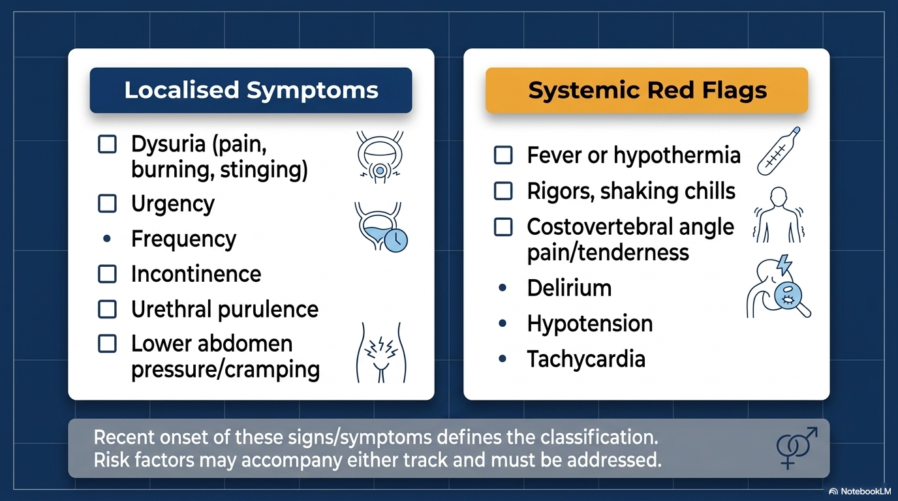
CLINICAL PRESENTATION

Slide 16
…contd
COMPLICATIONS
  Papillary necrosis esp. in pts with obstruction, diabetes, sickle cell disease, or analgesic nephropathy.
  Emphysematous pyelonephritis with the production of gas in renal and perinephric tissues, and occurs almost exclusively in diabetic pts.
  Xanthogranulomatous pyelonephritis occurs when chronic urinary obstruction (often by staghorn calculi), leads to suppurative destruction of renal tissue

Slide 17
INVESTIGATION
Urine dipstick
  Nitrite
  Leucocyte esterase
  Hematuria
NB
A dipstick test positive for nitrite or leukocyte esterase can confirm diagnosis of uncomplicated cystitis in pts with high pretest probability of disease.

Slide 18
…contd.
2. Urine Microscopic examination:
  Pyuria : Most truly infected patients have > 10 WBCs/μL.
    Pyuria in the absence of bacteriuria and of UTI is possible if patients have nephrolithiasis, a uroepithelial tumor, appendicitis, or inflammatory bowel disease or if the sample is contaminated by vaginal WBCs
  Microscopic hematuria occurs in up to 50% of patients, but gross hematuria is uncommon.
  WBC casts: pyelonephritis, glomerulonephritis, and noninfective tubulointerstitial nephritis.
Notes:
Since pyuria is present in almost all patients with UTI; its absence suggests an alternative diagnosis, particularly in patients who present with nonspecific symptoms. White cell casts, in particular, suggest a renal origin for pyuria. However, pyuria and bacteriuria may occasionally be absent if the infection does not communicate with the collecting system or if the collecting system is obstructed.

Slide 19
…contd.
3. Urine culture
  Is the diagnostic gold standard for UTI
  In women with symptoms of cystitis, a colony-count threshold of ≥10² bacteria/mL is more sensitive (95%) and specific (85%) than a threshold of 10⁵/mL for the diagnosis.
  For women, ASB requires two urine culture with >10⁵ of the same uropathogen in the absence of clinical symptoms referable to cystitis

Slide 20
INDICATION OF URINE CULTURES
Patients with urinary tract abnormalities or recent instrumentation
Patients with immunosuppression or significant comorbidities
Patients with recurrent UTIs (≥ 3/yr)
Pre-pubertal children
Pregnant or postmenopausal women and Men
Recent exposure to antibiotics
Patients whose symptoms suggest pyelonephritis or sepsis

Slide 21
DIAGNOSIS CONT…
Imaging
Ultrasonography CT
Urethrogram.
Kidney urethral bladder ultrasound KUB
NB
Used to detect any structure abnormality and complications i.e renal or perinephric abscess or sepsis
Especially in children and recurrent UTI
It evaluate for a process that may delay response to therapy or warrant intervention i.e calculus or obstruction

Slide 22
DIAGNOSIS
CT without contrast is the standard for demonstrating calculi, gas-forming infections, hemorrhage, obstruction, and abscesses
Contrast is needed to demonstrate alterations in renal perfusion
  Findings of pyelonephritis include localized hypodense lesions due to ischemia induced by marked neutrophilic infiltration and edema
MRI is not advantageous over CT except when avoidance of contrast dye or ionizing radiation is warranted

Slide 23
…contd.
Most adults do not require assessment for structural abnormalities unless the following occur:
The patient has ≥ 2 episodes of pyelonephritis
Infections are complicated
Nephrolithiasis is suspected
There is painless gross hematuria or new renal insufficiency
Fever persists for ≥ 72 h

Slide 24
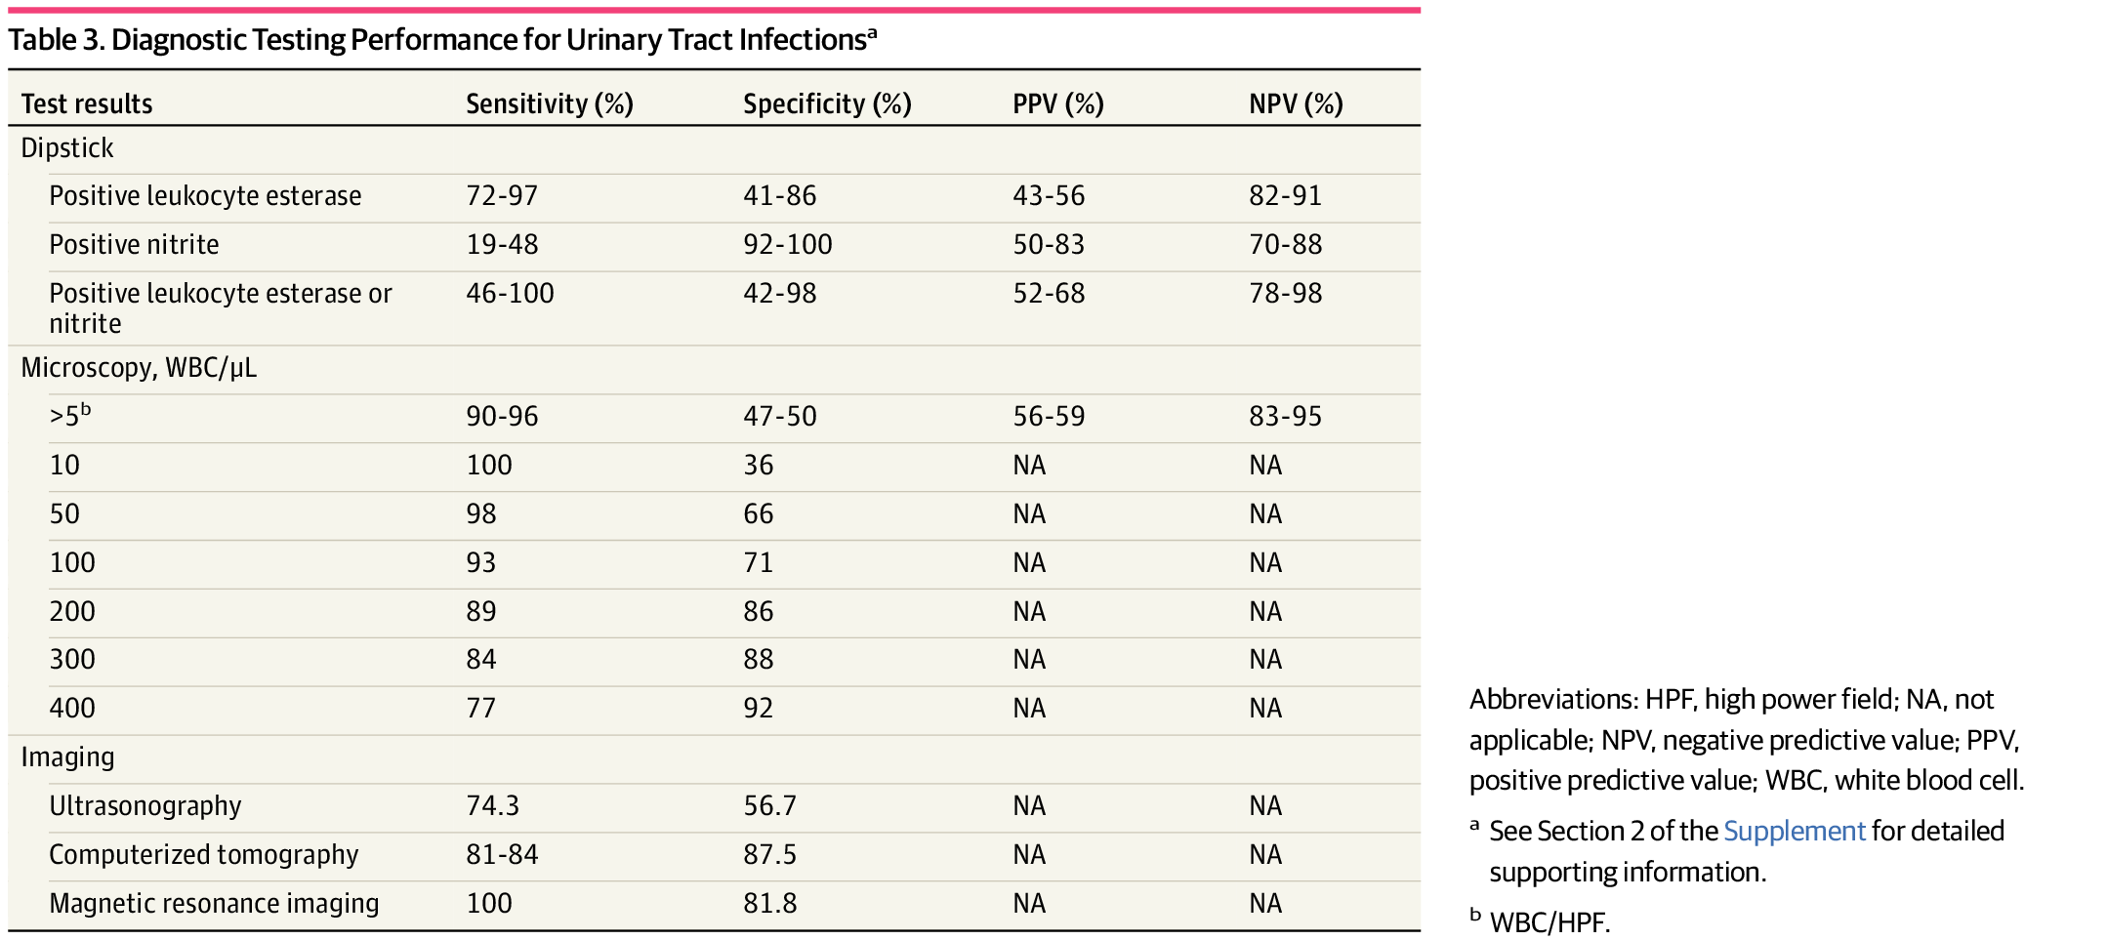

Slide 25
DIFFERENTIAL DIAGNOSIS
Acute urethral syndrome:
It occurs in women, involving dysuria, frequency and pyuria (dysuria-pyuria syndrome)
Unlike in cystitis, routine urine cultures are either negative.
Urethritis:
Possible causative organisms include Chlamydia trachomatis and Ureaplasma urealyticum, not detected on urine culture.

Slide 26
DIFFERENTIAL DIAGNOSIS
Noninfectious causes:
Anatomic abnormalities (eg, urethral stenosis),
Physiologic abnormalities (eg, pelvic floor muscle dysfunction),
Hormonal imbalances (eg, atrophic urethritis),
Localized trauma,
GI system symptoms, and inflammation

Slide 27
TREATMENT
Empiric antimicrobial therapy depends on;
Severity and type of infection
Local community resistance prevalence of Enterobacteriaceae (if known)
Susceptibility of prior urinary isolates,
Patient circumstances (such as allergy or expected tolerability, history of prior antimicrobial use)
Drug toxicity, interactions, availability, and cost.

Slide 28
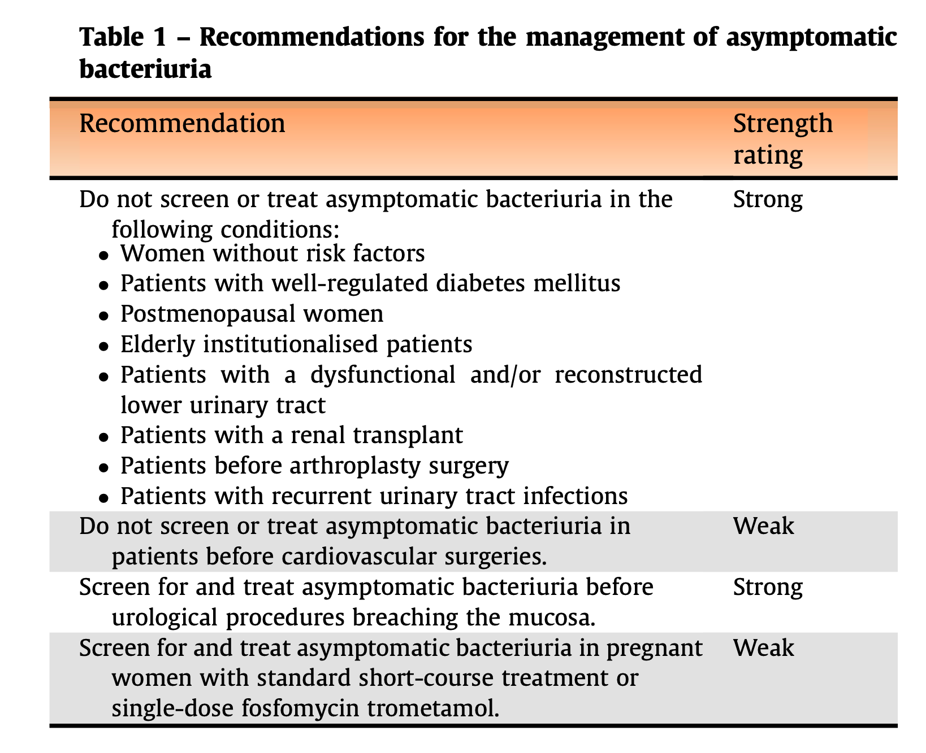
ASYMPTOMATIC BACTERIURIA MANAGEMENT

Slide 29
UNCOMPLICATED CYSTITIS MANAGEMENT
Routine post-treatment urinalysis or urine cultures are not indicated for asymptomatic patients.
If symptoms do not resolve by end of treatment, or if symptoms resolve but recur within 2 weeks, C/S should be performed.
  In this situation, it should be assumed that the infecting organism is not susceptible to the agent originally used.
Retreatment with a 7-d regimen using another agent should be considered.
Refs: Hooton TM, JAMA IM 2018; Gupta et al., CID 2011; EAU 2024; Albert et al., CID 2004; Kranjcec et al., World J Urol 2014

Slide 30
UNCOMPLICATED CYSTITIS MANAGEMENT
Agent
Dose
Duration
Evidence Level
Tanzania Context
Nitrofurantoin (1st line)
100 mg MR BD or 50 mg QDS
5 days
A-I
Variable availability; avoid if eGFR <45
Fosfomycin trometamol (1st line)
3 g stat (single dose)
1 day
A-I
Expensive in TZ; excellent stewardship value
Pivmecillinam (1st line)
400 mg BD
3–7 days
A-I
Limited availability in SSA
Co-trimoxazole (2nd line)
960 mg BD
3 days
A-I if <20% resist.
AVOID if local resistance >20% (often >70% TZ)
Ciprofloxacin (reserve only)
250 mg BD
3 days
A-I but reserve
EMA 2019 restriction; risk of C. difficile, tendinopathy; AVOID uncomplicated
Amoxicillin-clavulanate (if susceptible)
625 mg TDS
3–5 days
B-II
Use only with culture susceptibility; avoid empiric
Refs: IDSA Guidelines 2011 (Gupta et al.); EAU Urological Infections 2024; NICE NG112 2022; EMA Fluoroquinolone Safety Review 2019

Slide 31
COMPLICATED CYSTITIS MANAGEMENT
cUTI management should MANDATORY address the urological abnormality or the underlying complicating factor.
Treatment for 7 d to 14 d (14 d for men when prostatitis cannot be excluded)
If patient is hemodynamically stable and has afebrile for at least 48 h, a shorter duration (eg, 7 d) may be considered.
Refs: EAU Guidelines Urological Infections 2024; Nickel JC, Eur Urol 2007; Wagenlehner FM, Eur Urol 2016; Schaeffer AJ, NEJM 2006

Slide 32
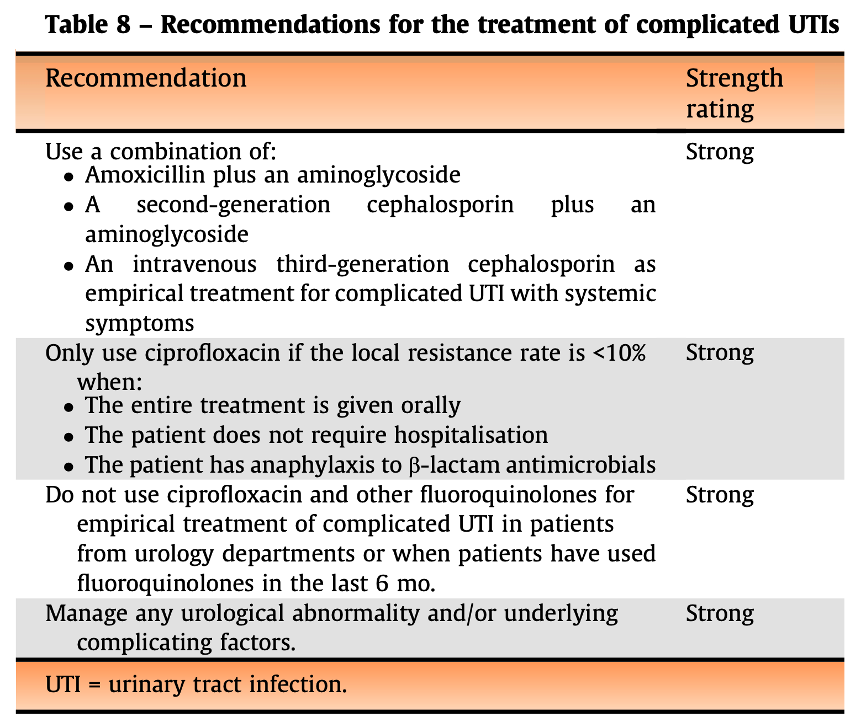
Complicated UTI Management
Refs: EAU Guidelines Urological Infections 2024; Nickel JC, Eur Urol 2007; Wagenlehner FM, Eur Urol 2016; Schaeffer AJ, NEJM 2006

Slide 33
PYELONEPHRITIS MANAGEMENT
Fluoroquinolones and cephalosporins are only recommended agents for oral empiric treatment
  However they achieve significantly lower blood and urinary concentrations than the IV route.
Other agents i.e nitrofurantoin, oral fosfomycin, and pivmecillinam should be avoided as there are insufficient data regarding their efficacy.
Refs: EAU Guidelines Urological Infections 2024; Nickel JC, Eur Urol 2007; Wagenlehner FM, Eur Urol 2016; Schaeffer AJ, NEJM 2006

Slide 34
PYELONEPHRITIS MANAGEMENT
If hospitalized should be treated initially with an IV regimen:
  fluoroquinolone, an aminoglycoside (with or without ampicillin), or an extended-spectrum cephalosporin or penicillin.
  Carbapenems and novel broad-spectrum agents should only be used if early culture results indicates presence of MDR.
The choice between these agents should be based on local resistance patterns.
Refs: EAU Guidelines Urological Infections 2024; Nickel JC, Eur Urol 2007; Wagenlehner FM, Eur Urol 2016; Schaeffer AJ, NEJM 2006

Slide 35
PYELONEPHRITIS MANAGEMENT
For men whenever a complicating factor is suspected, a minimum treatment duration of 2 wk is recommended, preferably with a fluoroquinolone, as prostatic involvement is frequent
Refs: EAU Guidelines Urological Infections 2024; Nickel JC, Eur Urol 2007; Wagenlehner FM, Eur Urol 2016; Schaeffer AJ, NEJM 2006

Slide 36
PYELONEPHRITIS MANAGEMENT
Duration: 10–14 days total (IV → oral switch at 48–72h if improving, afebrile, tolerating orals)
Source control:
  Ureteral stent or percutaneous nephrostomy if obstruction
  Renal abscess >3 cm: CT-guided drainage + antibiotics; <3 cm: IV antibiotics alone 4–6 weeks
  Perinephric abscess: mandatory surgical/percutaneous drainage; cultures guide prolonged therapy
Refs: EAU Guidelines Urological Infections 2024; Nickel JC, Eur Urol 2007; Wagenlehner FM, Eur Urol 2016; Schaeffer AJ, NEJM 2006

Slide 37
Urosepsis – Sepsis-3 Framework & Management Bundles
1-Hour Bundle (SSC 2018 vs SSC 2026)
Empiric Antibiotic Strategy
1. Measure lactate; re-measure if >2 mmol/L
2. Blood cultures ×2 (aerobic + anaerobic) BEFORE antibiotics
3. Broad-spectrum antibiotics within 1 hour of recognition
4. Crystalloid 30 mL/kg IV if lactate ≥4 mmol/L or hypotension (MAP <65)
5. Vasopressors (norepinephrine) if fluid-unresponsive MAP <65
SOURCE CONTROL: ureteral stent or percutaneous nephrostomy within 6–12h if obstructive uropathy (Grade A; EAU 2024)
De-escalate at 48–72h based on culture; reduce carbapenem exposure; document indication and planned duration
Community-acquired urosepsis (low ESBL risk):
Piperacillin-tazobactam 4.5g TDS IV OR Ceftriaxone 2g OD IV
Community-acquired urosepsis (high ESBL risk TZ):
Ertapenem 1g OD IV OR Meropenem 1g TDS IV
Hospital-acquired/ICU urosepsis:
Meropenem 1g TDS ± vancomycin (if MRSA risk) OR ceftazidime-avibactam (KPC)
Pseudomonas risk (ICU, prior hospitalization, FQ exposure):
Meropenem 2g TDS extended infusion (4h) OR ceftolozane-tazobactam
Candida urosepsis (ICU, immunosuppressed):
Micafungin 100mg OD IV OR fluconazole if stable + susceptible species
MONITORING: CRP/PCT at 48–72h; SOFA score trends; culture-directed de-escalation; duration 10–14 days IV then oral
Refs: Singer et al., JAMA 2016 (Sepsis-3); Levy et al., Intensive Care Med 2018 (SSC bundles); EAU 2024; IDSA 2011

Slide 38
RECURRENT UTI MANAGEMENT
BEHAVIOURAL INTERVENTIONS:
  post-coital voiding,
  increased fluid intake (>1.5L/day) – RCT showed 50% reduction in rUTI (Hooton et al., JAMA IM 2018);
  wiping technique, avoid spermicides
Refs: EAU Guidelines Urological Infections 2024; Nickel JC, Eur Urol 2007; Wagenlehner FM, Eur Urol 2016; Schaeffer AJ, NEJM 2006

Slide 39
RECURRENT UTI MANAGEMENT
D-MANNOSE: competitive inhibitor of FimH adhesin; RCT vs nitrofurantoin maintenance showed non-inferior recurrence prevention (Kranjcec et al., World J Urol 2014); 2g OD dosing
CRANBERRY PRODUCTS: meta-analysis 2023 (Juthani-Mehta et al.): modest reduction rUTI (RR 0.74, 95%CI 0.55–0.98)
Refs: EAU Guidelines Urological Infections 2024; Nickel JC, Eur Urol 2007; Wagenlehner FM, Eur Urol 2016; Schaeffer AJ, NEJM 2006

Slide 40
CAUTI PREVENTION
PREVENTION BUNDLE (SHEA/IDSA/HICPAC):
Avoid unnecessary catheterization each day increases 3-8% each day;
Aseptic insertion;
Maintain closed drainage;
Daily assessment + remove ASAP;
Hand hygiene; reduces CAUTI 50–70% when fully implemented (Saint et al., Lancet ID 2016)
Refs: EAU Guidelines Urological Infections 2024; Nickel JC, Eur Urol 2007; Wagenlehner FM, Eur Urol 2016; Schaeffer AJ, NEJM 2006

Slide 41
CAUTI PREVENTION
Catheter alternatives: external (condom) catheters in men – lower UTI risk than indwelling (Niel-Weise et al., Cochrane 2012);
Intermittent self-catheterisation (ISC) – preferred for neurogenic bladder
Antimicrobial catheters:
  silver alloy hydrogel – meta-analysis marginal benefit (Lam et al., J Urol 2014)
  nitrofurantoin-impregnated – limited evidence; not recommended for routine use (NICE 2012)
Refs: EAU Guidelines Urological Infections 2024; Nickel JC, Eur Urol 2007; Wagenlehner FM, Eur Urol 2016; Schaeffer AJ, NEJM 2006

Slide 42
CAUTI PREVENTION
For catheterized patients, pyuria is not diagnostic for CA-UTI.
  Neither the presence, absence, or degree of pyuria NOR the presence or absence of odorous or cloudy should not be used to differentiate CA-ABU from CA-UTI.
Pyuria accompanying CA-ABU should not be interpreted as an indication for antimicrobial treatment.
The absence of pyuria in a symptomatic patient suggests a diagnosis other than CA-UTI
Refs: EAU Guidelines Urological Infections 2024; Nickel JC, Eur Urol 2007; Wagenlehner FM, Eur Urol 2016; Schaeffer AJ, NEJM 2006

Slide 43
CAUTI PREVENTION
DURATION: 7 days (symptoms resolve rapidly); 10–14 days (delayed response); 5 days levofloxacin (susceptible organism) – non-inferior in RCT (Hooton et al., CID 2010)
CATHETER MANAGEMENT: Change/remove catheter at start of antibiotics; new catheter specimen sent before therapy
CANDIDA CAUTI: fluconazole 400 mg OD × 14 days (susceptible C. albicans); remove/change catheter; treatment only if symptomatic or immunosuppressed
Refs: IDSA CAUTI Guidelines (Hooton et al., CID 2010); HICPAC 2009; Saint et al., Lancet ID 2016; IDSA ASB 2019

Slide 44
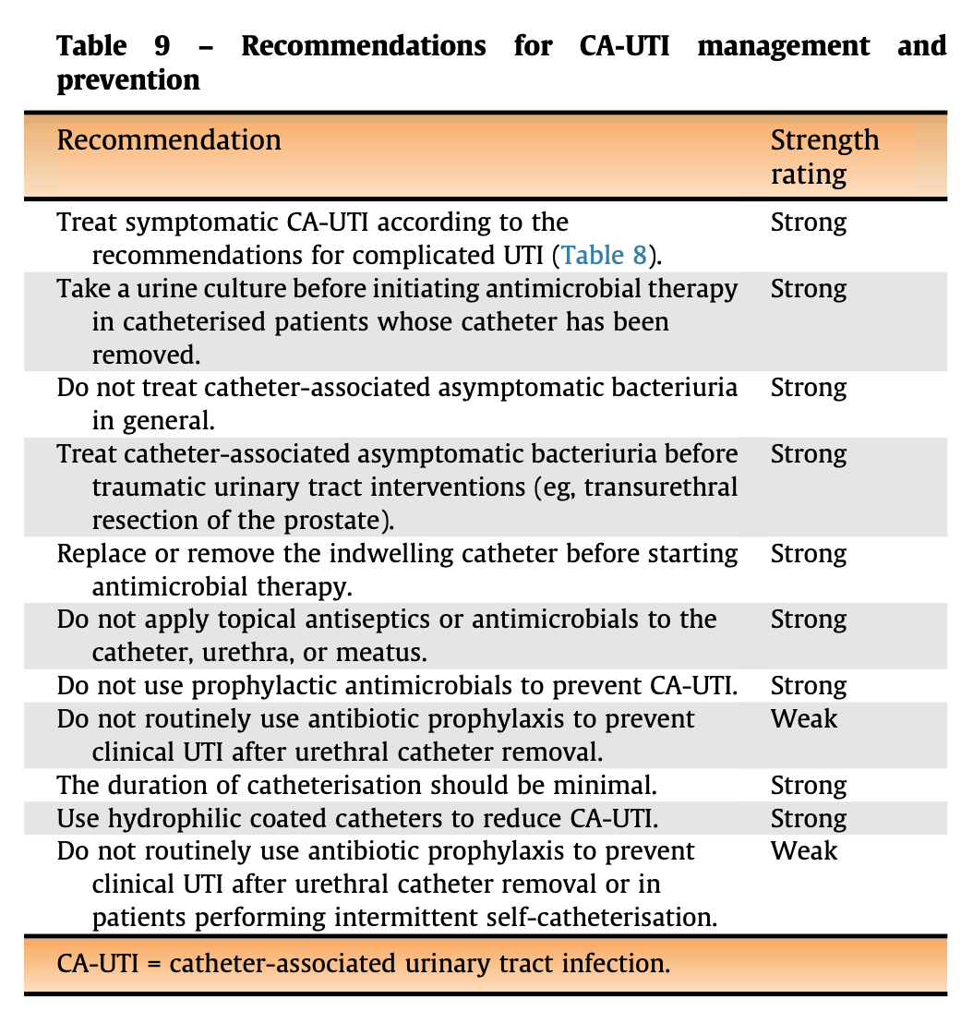
CAUTI – Prevention & Treatment Strategies
Refs: IDSA CAUTI Guidelines (Hooton et al., CID 2010); HICPAC 2009; Saint et al., Lancet ID 2016; IDSA ASB 2019

Slide 45
UTI in Diabetes Mellitus & Immunosuppression
Diabetes Mellitus
Immunocompromised Host
DM increases UTI risk 2–5x: impaired neutrophil chemotaxis, glycosuria, neuropathic bladder with PVR urine, vascular disease
Higher risk of complicated UTI: emphysematous pyelonephritis (90% DM), renal papillary necrosis, fungal UTI, Klebsiella hvKP syndrome
Glycaemic control optimisation key adjunct to antibiotic therapy
SGLT2 inhibitors (dapagliflozin, empagliflozin): increase UTI and genital mycotic infection risk; counsel patients; withhold if active UTI
Duration of treatment: extend to 10–14 days for cystitis (7 days minimum); 14 days for pyelonephritis in DM
Nitrofurantoin: AVOID if eGFR <45 mL/min/1.73m² (inadequate urinary concentrations + peripheral neuropathy risk)
HIV: CD4 <200 → markedly increased UTI risk; unusual organisms (Salmonella, Nocardia, CMV, MAC) + typical uropathogens
Always screen for renal TB in HIV+ with sterile pyuria; exclude viral nephritis (HIVAN) when pyuria + proteinuria
Transplant recipients: CMV viruria (asymptomatic – no treatment); BK virus nephropathy vs UTI – urine cytology 'decoy cells'
Neutropaenic patients: UTI may be oligosymptomatic; broad-spectrum cover including Pseudomonas; adjust for mucositis
Corticosteroids: mask fever/signs; maintain high suspicion; fungi (Candida, Aspergillus) in prolonged courses
Spinal cord injury: neurogenic bladder → colonisation universal; treat only symptomatic episodes; ISC preferred; avoid prophylaxis (select for MDR)

Slide 46
Fungal Urinary Tract Infections – Candiduria & Invasive Candidiasis
Candiduria: >98% asymptomatic in non-neutropaenic, non-transplant patients – DO NOT TREAT (IDSA 2016, Grade A-II)
Treat candiduria if: symptomatic UTI, neutropaenia, renal transplant, pre-urological procedure, premature neonate
C. albicans (60%): fluconazole 200 mg OD × 14 days (cystitis) or 400 mg OD × 14 days (pyelonephritis/upper tract)
C. glabrata (Nakaseomyces glabratus): reduced fluconazole susceptibility; amphotericin B bladder irrigation or systemic therapy; micafungin if bloodstream
C. tropicalis: fluconazole usually effective; increasing azole resistance reported in Africa (Mulu et al., 2015)
Fluconazole bladder irrigation: NOT recommended (no benefit over systemic therapy; IDSA 2016)
Amphotericin B deoxycholate 0.3–1 mg/kg/day: severe/resistant candida UTI; nephrotoxicity concern – use liposomal if eGFR <30
Echinecandins (micafungin, caspofungin): excellent for bloodstream/systemic; POOR urinary concentrations – avoid for uncomplicated CAUTI
Remove/change catheter: mandatory for symptomatic candiduria; eliminate predisposing factors (broad-spectrum antibiotics, immunosuppression, hyperglycaemia)
Refs: Pappas et al., CID 2016 (IDSA Candida Guidelines); Kullberg & Arendrup, NEJM 2015; EAU 2024

Slide 47
UTI in Renal Transplant Recipients
Most common infection post-transplant (45–75% of all infections); 3× increased risk acute rejection with pyelonephritis (Fiorante et al., KI 2011)
Three phases: <1 month (nosocomial, ESKAPE organisms, CAUTI, surgical site); 1–6 months (opportunistic: CMV, BK virus, PCP + bacterial); >6 months (community uropathogens, chronic complications)
BK virus nephropathy vs UTI: urine cytology 'decoy cells'; plasma BK viral load >10,000 copies/mL; management = reduce immunosuppression; no proven antiviral therapy
ALL bacteriuria in transplant recipients should be screened and treated (even 'asymptomatic') in first 3 months post-transplant – controversial beyond 3 months; IDSA 2019 update suggests no treatment ASB after 3 months
Empiric therapy: ESBL-covering regimen given high ESBL prevalence; ertapenem IV for severe episodes; adjust for nephrotoxicity
Drug interactions: fluoroquinolones + calcineurin inhibitors (tacrolimus QTc; rifampicin – major enzyme induction); monitor immunosuppressant levels
Prophylaxis: co-trimoxazole DS 960 mg 3×/week × 6–12 months (PCP prophylaxis incidentally reduces UTI – reduces bacterial UTI by 70%); trim alone if sulfa allergy
VUR in transplant ureter: technical complication; evaluate with VCUG; may require surgical revision
Refs: Fiorante et al., KI 2011; IDSA 2019 Transplant Infection Guidelines; Kidney Disease: Improving Global Outcomes (KDIGO) 2020

Slide 48
Urogenital Tuberculosis & Schistosomiasis – Tanzania Context
Urogenital TB
S. haematobium
RENAL TB: Haematogenous seeding from primary pulmonary focus; latency 5–20 years; presents as sterile pyuria, frequency, haematuria, flank pain
Diagnosis: 3× early morning urine for AFB smear & culture (gold standard but 6–8 weeks); Xpert MTB/RIF: sensitivity 83%, specificity 98% – first choice in resource-limited settings
IVU/CT Urogram: moth-eaten calyces, infundibular stenosis, obliterated calyces, ureteral strictures, autonephrectomy (putty kidney)
Treatment: RHZE × 2 months + RH × 4 months (standard 6-month TB regimen); ureteral stenting may be needed for strictures
In Tanzania: always consider in HIV+ patients with sterile pyuria or unexplained haematuria; co-treat HIV (HAART timing per standard guidelines)
S. HAEMATOBIUM: endemic Tanzania (Lake Zone, coastal areas, irrigation schemes); ~170 million at risk worldwide (WHO 2023)
Pathophysiology: cercariae → schistosomulae → adult worms in vesical plexus → egg deposition → granulomatous inflammation → bladder fibrosis, calcification
Complications: haematuria (terminal, painless), obstructive uropathy, bladder cancer (squamous cell, WHO Group 1 carcinogen), secondary bacterial UTI, genital schistosomiasis
Diagnosis: urine filtration for ova (peak 10am–2pm, midday sample); PONT technique; urine PCR; cystoscopy – 'sandy patches', contact bleeding
Treatment: Praziquantel 40 mg/kg stat (single dose); repeat at 6 months if heavy burden; MDA programmes in endemic areas
UTI co-infection: increased susceptibility to E. coli/Salmonella after schistosome-mediated barrier disruption (Downs et al., PLoS NTD 2011)

Slide 49
Vaccines Against UTIs – Current Evidence & Pipeline
Vaccine / Agent
Mechanism
Stage
Evidence
Status 2024
OM-89 (Urovax/Urostim)
Oral E.coli lysate; stimulates mucosal & systemic immunity
Phase III
RCT: 40% ↓ rUTI recurrence (Bauer 2005, J Urol)
Licensed in Europe; oral 28d course
FimCH vaccine
Targets FimH adhesin (type-1 fimbriae); blocks E. coli–uroplakin binding
Phase I/II
Mouse models: 95% protection; human trials ongoing (Langermann 1997, Science)
Clinical trials ongoing
MrpH fimbrial vaccine
Proteus mirabilis MR/P fimbriae adhesin
Preclinical
Strong murine protection against catheter-associated Proteus UTI (Scavone 2004)
Preclinical
Type-1 fimbrial conjugate (ExPEC4V)
4-component glycoconjugate vs ExPEC
Phase II
Well tolerated; immunogenic; efficacy RCT ongoing (Huttner et al., Vaccine 2017)
Phase II completed
mRNA-based UPEC vaccine
mRNA encoding multiple UPEC antigens (fimbriae, siderophores, toxins)
Discovery
Preclinical concept leveraging mRNA platform (post-COVID-19 technology translation)
Research phase
Probiotics (vaginal/oral Lactobacillus)
Restore protective urogenital microbiome; competitive exclusion of uropathogens
Phase II/III
Cochrane 2022: insufficient evidence; ongoing RCTs with specific strains (LACTIN-V trial)
Investigational
Refs: Bauer et al., J Urol 2005; Langermann et al., Science 1997; Huttner et al., Vaccine 2017; Stapleton et al., Lancet ID 2021 (LACTIN-V)

Slide 50
KEY TAKEAWAYS
ANATOMY & PATHOPHYSIOLOGY: Ascending route dominates; FimH-mediated adhesion, IBC formation, and biofilm are critical mechanisms of UPEC pathogenicity and recurrence
CLASSIFICATION: Uncomplicated vs complicated vs CAUTI vs urosepsis – classification drives management intensity and antibiotic selection
AMR IN TANZANIA: ESBL-E. coli >40% community; avoid empiric fluoroquinolones and co-trimoxazole without culture; ertapenem is key agent for ESBL-confirmed cases
DIAGNOSTICS: Dipstick + MSU culture when indicated; PCT to distinguish upper vs lower UTI; CT for complicated cases; avoid over-investigation in uncomplicated cystitis
MANAGEMENT: Short-course nitrofurantoin/fosfomycin for uncomplicated cystitis; 7-day ciprofloxacin for pyelonephritis; PCT-guided de-escalation; source control for urosepsis is life-saving
STEWARDSHIP: Culture before antibiotics in complicated UTI; de-escalate at 48–72h; optimal duration (3d/5d/7d) evidence-based; avoid ASB treatment except pregnancy/pre-procedures
EMERGING THERAPIES: OM-89 oral immunostimulant (licensed; Level A evidence); LACTIN-V intravaginal probiotic (Phase II positive); novel β-lactam/inhibitor combos for MDR; phage therapy – promising but experimental

Slide 51
REFERENCES
1. Gupta K et al. International clinical practice guidelines for the treatment of acute uncomplicated cystitis and pyelonephritis in women: 2010 update by the IDSA and ESMID. CID 2011;52(5):e103–e120.
2. EAU Urological Infections Guidelines 2024. European Association of Urology. Available: uroweb.org/guidelines.
3. Hooton TM et al. Diagnosis, prevention, and treatment of catheter-associated urinary tract infection in adults: 2009 international clinical practice guidelines from IDSA. CID 2010;50(5):625–663.
4. Nicolle LE et al. Clinical practice guideline for the management of asymptomatic bacteriuria: 2019 update by IDSA. CID 2019;68(10):e83–e110.
5. Singer M et al. The Third International Consensus Definitions for Sepsis and Septic Shock (Sepsis-3). JAMA 2016;315(8):801–810.
6. Hoberman A et al. Antimicrobial prophylaxis for children with vesicoureteral reflux (RIVUR trial). NEJM 2014;370(25):2367–2376.
7. Flores-Mireles AL et al. Urinary tract infections: epidemiology, mechanisms of infection and treatment options. Nat Rev Microbiol 2015;13(5):269–284.
8. Sandberg T et al. Ciprofloxacin for 7 days versus 14 days in women with acute pyelonephritis. BMJ 2012;344:e3500.
9. Eliakim-Raz N et al. Shorter vs longer duration of antibiotic treatment for UTI in women. BMJ 2023;382:e074462.
10. WHO Global Antimicrobial Resistance and Use Surveillance System (GLASS) Report 2023. Geneva: WHO
11. Mshana SE et al. Prevalence of ESBL-producing E. coli and Klebsiella pneumoniae in Tanzania. Eur J Clin Microbiol Infect Dis 2016;35(3):443–449.
12. Moyo SJ et al. Antimicrobial resistance profiles and genotypes of E. coli from UTIs in Tanzania. BMC Infect Dis 2022;22:186.

